Slide 1

Customer Shopping Behavior Analysis
Uncovering insights from transactional data to drive strategic business decisions.

Slide 2

Project Overview
Goal
Analyze 3,900 purchases for spending patterns, customer segments, product preferences, and subscription behavior.
Data
Transactional data from 3,900 purchases across various product categories.

Slide 3

Dataset Summary
Key Features
Data Snapshot
Customer demographics (Age, Gender, Location, Subscription Status)
3,900 Rows
Purchase details (Item, Category, Amount, Season, Size, Color)
18 Columns
Shopping behavior (Discount, Promo Code, Previous Purchases, Frequency, Review Rating, Shipping Type)
37 missing values in Review Rating

Slide 4
Exploratory Data Analysis (Python)
01
02
03
Data Preparation
Column Standardization
Feature Engineering
Loading, initial exploration, and handling missing values (Review Rating imputed with median).
Created age_group and frequency_purchase_days columns.
Renamed columns to snake_case for readability.
04
05
Data Consistency
Database Integration
Dropped redundant promo_code_used column.
Loaded cleaned data into PostgreSQL for SQL analysis.

Slide 5

Data Analysis (SQL)
Revenue by Gender
Top 5 Products by Rating
Female: $75,191
Gloves (3.86), Sandals (3.84), Boots (3.82), Hat (3.80), Skirt (3.78)
Male: $157,890
Shipping Type Comparison
Standard: $58.46
Express: $60.48

Slide 6


Subscriber vs. Non-Subscriber
Subscribers (Yes)
1,053 customers
Avg. Spend: $59.49
Total Revenue: $62,645
Non-Subscribers (No)
2,847 customers
Avg. Spend: $59.87
Total Revenue: $170,436

Slide 7
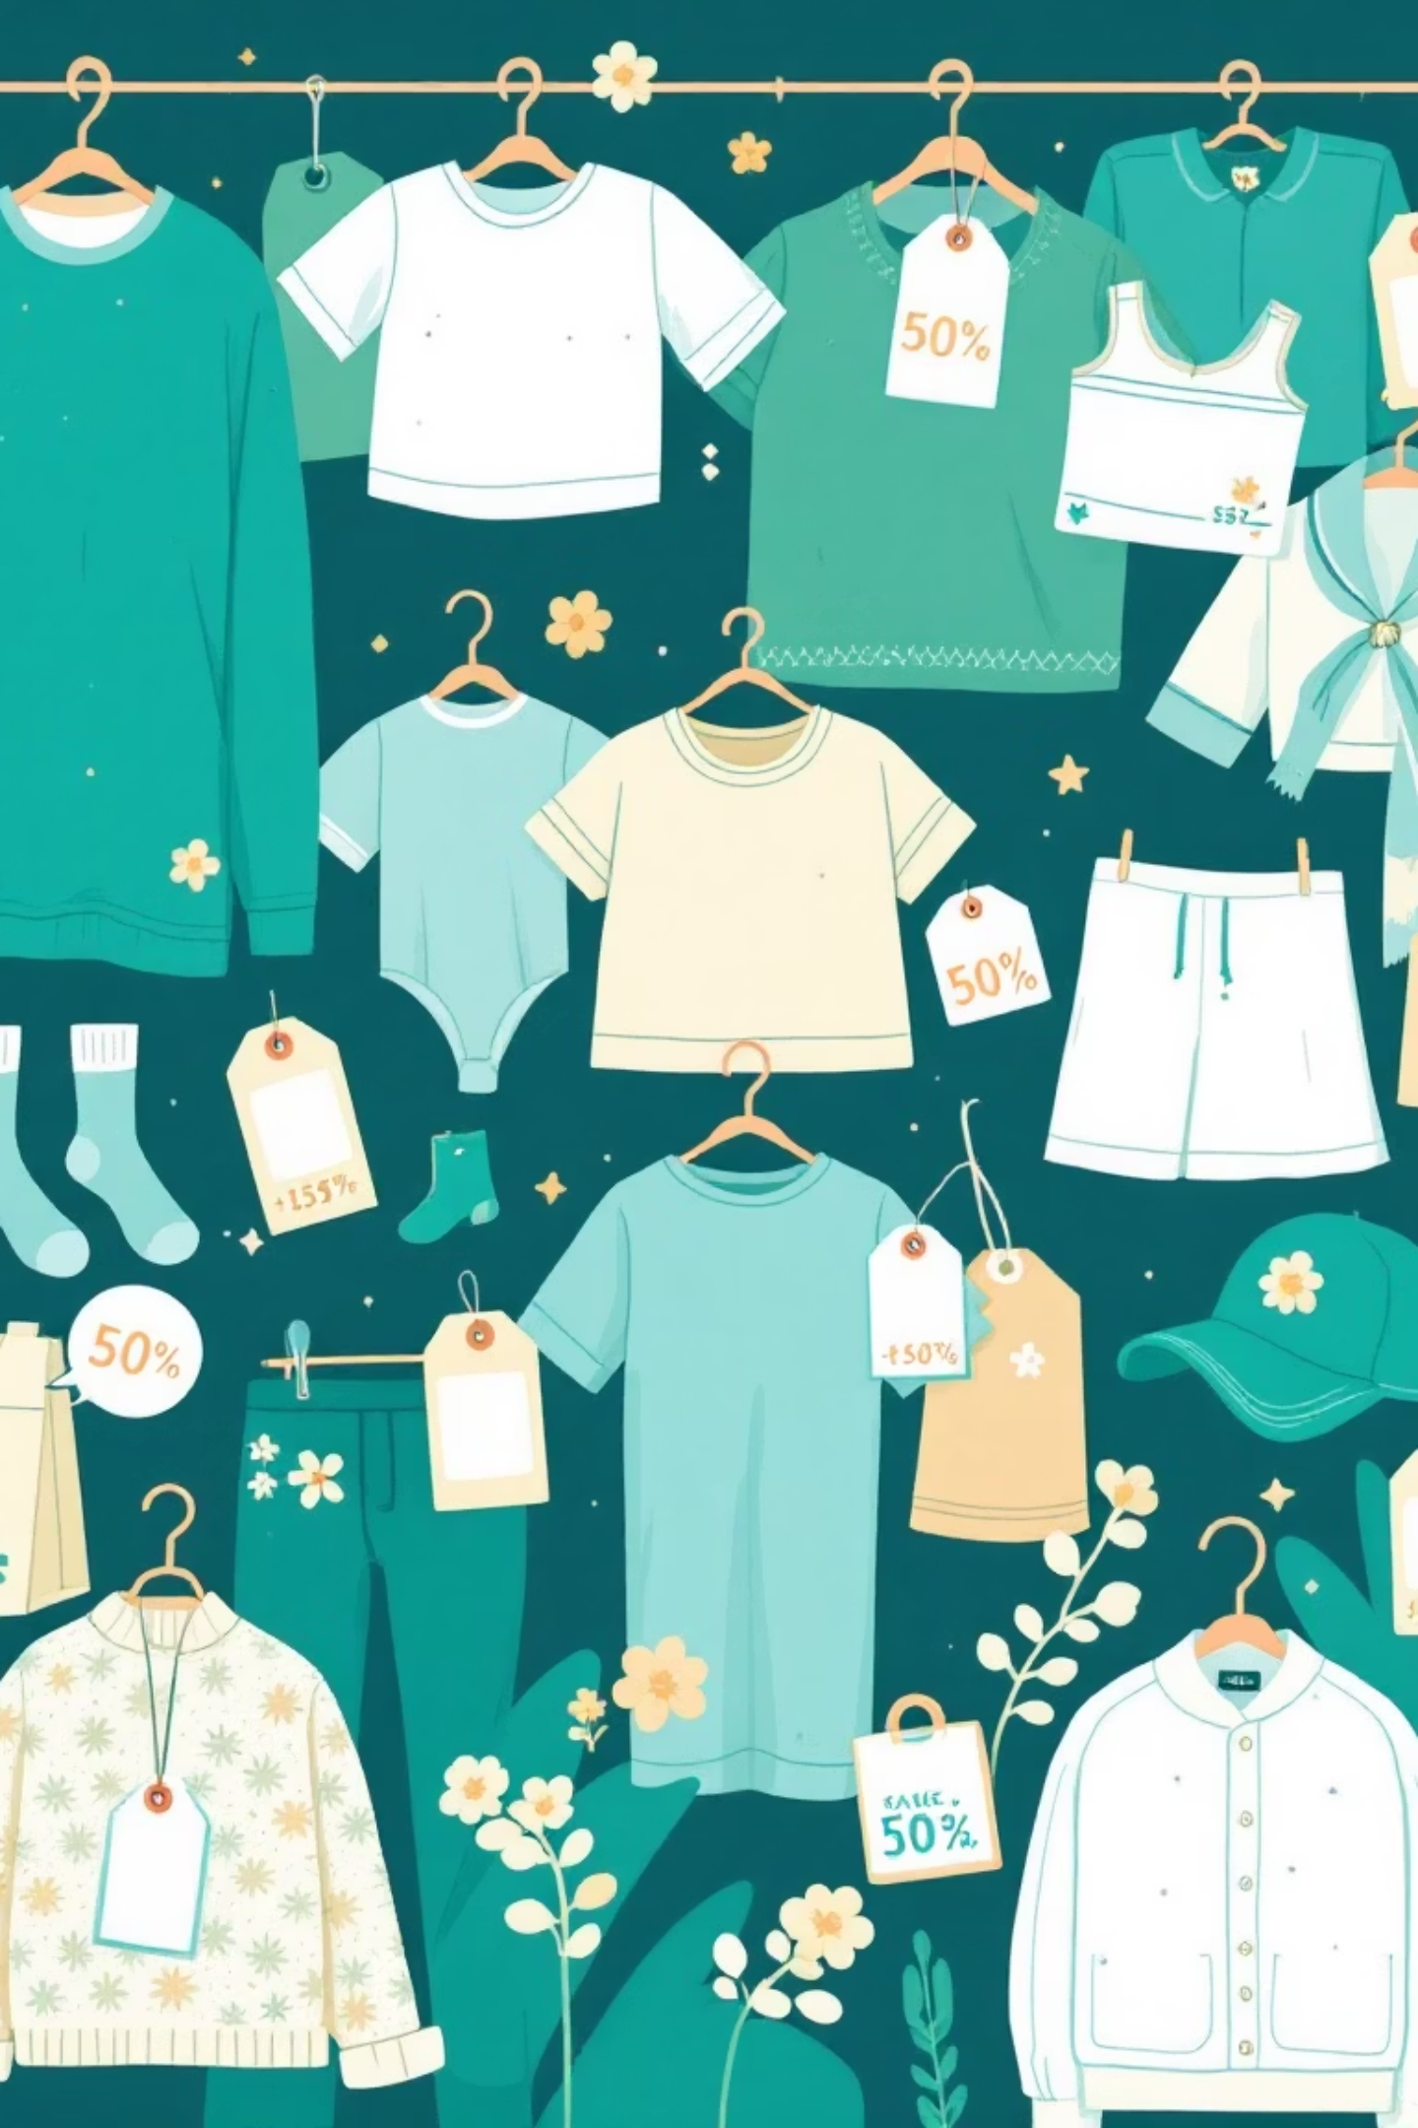
Key Product Insights
Discount-Dependent
Hat (50%), Sneakers (49.66%), Coat (49.07%), Sweater (48.17%), Pants (47.37%)
Customer Segmentation
Loyal (3116), Returning (701), New (83)

Slide 8

Age Group & Subscription Trends
Revenue by Age Group
Repeat Buyers & Subscriptions
Young Adult: $62,143
Middle-Aged: $59,197
Customers with >5 purchases:
Adults: $55,978
No Subscription: 2,518
Senior: $55,763
Yes Subscription: 958

Slide 9
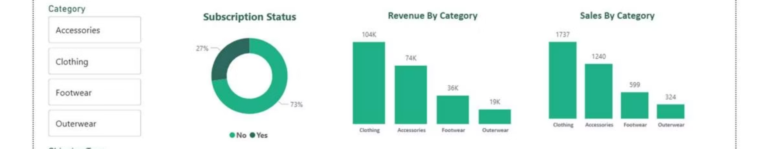
Dashboard in Power BI
Visualizing key metrics and trends for actionable insights.

Slide 10

Business Recommendations
Boost Subscriptions
1
Promote exclusive benefits, especially for female customers.
Customer Loyalty
2
Reward repeat buyers to foster "Loyal" segment growth.
Review Discount Policy
3
Balance sales boosts with margin control.
Product Positioning
4
Highlight top-rated and best-selling products in campaigns.
Targeted Marketing
5
Focus on high-revenue age groups and express-shipping users.

